Slide 1
Online
Designing for Performance
  Performance metrics
  A systems approach to designing for performance
  Mechanism for Improving Performance
  Fighting bottlenecks
  An example: the I/O bottleneck
Suggested reading
  6.1

Slide 2
Performance Goals
The specification of a computer system typically includes performance goals
  Explicit (or implicit)
  Eg. the specification may say how many concurrent users the system should be able to support

Slide 3
Bottleneck
Typically the simplest design fails to meet these goals
  The design has a bottleneck
    a stage in the computer system
    that takes longer to perform its task than any of the other stages
To overcome bottlenecks
  Creating a design that performs well
  Yet is simple and modular

Slide 4
Reasons for Performance Bottleneck
The rate of improvement of technology
  Restricted in some dimensions, while rapid in other dimensions
    Limits imposed by physics, technology, or economics

Slide 5
Physical Limits
The speed of light limits
  how fast signals travel from end of a chip to another
  the number of memory elements that can be at distance zero from the processor
  how fast a network message can travel in the Internet
Many other physical limits appear in computer systems
  Eg. power and heat dissipation

Slide 6
Trade-off
shrinking a chip
  Makes the chip faster
  Reduces the area from which heat can be dissipated
  The power dissipation goes up as the chip faster
The speed of a laptop vs. its power consumption
  Minimize a laptop’s power consumption so that the battery lasts longer
    A designer’s point of view
  High-performance laptops with high-quality screens
    Consumers’ point of view

Slide 7
Limits and Trade-offs
Several Limits
  Physical limits are only one
  Algorithmic, reliability, and economic ones
More limits means
  Generally more trade-offs
  A higher risk of bottlenecks

Slide 8
Scheduling
Several clients may share a device
  a device is busy serving one client
  other clients must wait until the device comes available
Which client should receive the device first?

Slide 9
Scheduling
Should the device do the following?
  First performs the request that requires little work
  At the cost of delaying the request that requires a lot of work
Goals of a scheduling plan for a device
  Doesn’t starve some clients in favor of others
  Provides low turn-around time for each individual client request
  Has little overhead so that it can serve many clients

Slide 10
Scheduling
Impossible to maximize simultaneously all of these goals
Must make trade-offs
  may favor one class of requests over another
  result in bottlenecks for the unfavored classes of requests

Slide 11
Two Challenges
The benefits of optimizations in the context of technology improvements
  Some bottlenecks are intrinsic ones
    Require careful thinking to ensure that the system runs faster than the performance of the slowest stage
  Some bottlenecks are technology dependent
    Time may eliminate these, as technology improves
Maintaining the simplicity of the design

Slide 12
Intrinsic Bottlenecks
Whether a bottleneck is intrinsic or not
  Difficult to decide sometimes
Relationship between
  A performance optimization for the product release
  The time the product ships
  Technology improvements may have removed the bottleneck completely
The design hint:
  when in doubt use brute force

Slide 13
Maintaining the simplicity of the design
Different devices with
  approximately the same high level function
  radically different performance
Challenge
  Abstract devices
    Used through a simple uniform interface
Transparently extend the effective size of a CMOS RAM to the size of a magnetic disk
  Implementation of the READ and WRITE interface for memory

Slide 14
Performance Metrix
Computer Systems can be viewed as interconnected modules
Four common metrics:
  Capacity
  Utilization
  Latency
  Throughput

Slide 15
Capacity and Utilization
Capacity
  Size or amount of a service
    Blocks on storage or memory devices
    Cycles on a processor
    Requests per second for a web server
    Bits per second on a network link
Utilization
  Fraction of capacity used by a workload
    CPU is 50% busy, rest in idle loop
    75% of disk blocks are allocated
    Webserver is running at 20% of capacity
    20% of the time network is busy

Slide 16
Capacity and Utilization
Overhead
  Resources used by a layer beyond basic needs
    OS takes 25% of cycles & 2GB of the memory
    10% allocated to file metadata
Useful work
  Left over after overheads subtracted
  Resources delivered to the layers above
    How much memory/disk space do I get after Windows is done?
    File blocks occupy 80% of the disk, rest is metadata

Slide 17
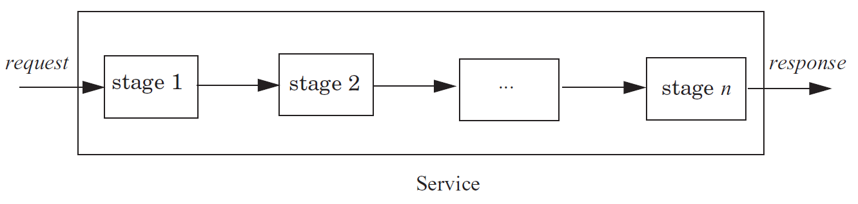
Latency
The time it takes from start to finish
  Webserver – Time from request to response
  Network – Time from send() until receive() done
  Procedure – Time from call until return
For a multi-step process (Steps A + B)
  LatencyA+B ≥ LatencyA + LatencyB

Slide 18
Throughput
Rate at which work is done
  Webserver – Requests per second
  Network – Bytes per second
  Procedure – Calls per second
Pipeline of modules
  ThoughputA+B ≤ minimum(ThroughputA,ThroughputB)
  Bottleneck
Relationship with latency when processing serial
  Throughput = 1 / (Latency)

Slide 19
Latency and Throughput for Pipes
Consider a water pipe
Latency
  How long does it take for water entering one end to exit the other end
    Factors: Length of the pipe and water speed
    Units: Seconds
Throughput
  How much water per second is moving through the pipe
    Factors: Diameter of the pipe and water speed
    Units: Gallons/second

Slide 20
Performance Optimizations
Take a whole systems views
  Much time wasted optimizing things that don’t need to be optimized
    Brute force & d(technology)/dt
      “Bottlenecks occur in surprising places, so don't try to second guess and put in a speed hack until you have proven that's where the bottleneck is.” - Rob Pike
      “The First Rule of Program Optimization: Don't do it. The Second Rule of Program Optimization (for experts only!): Don't do it yet.” - Michael A. Jackson

Slide 21
Iterative Approach to Performance
Measure the system
  Make sure there is really a problem
Identify the performance bottleneck
  Like root cause analysis
Model the proposed enhancement
  Assume bottleneck is removed
  Identify next bottleneck
  How much improvement? None?
Measure the new system
  Did it help enough? If not, discard.
Go to step 1.

Slide 22
The Law of Diminishing Returns
The more one improves some measure of goodness, the more effort the next improvement will require
  Taken from Economics
Examples:
  Performance optimizations
    You get the low hanging fruit, the rest take more work
    Trickier, more complex algorithms
  Complex control needed for high utilization
    Eg. Distributed file system performance

Slide 23
Improving Bottlenecks
Latency is the harder of the problems
  Frequently fundamental limits
    Speed of CPU
    Speed of communication link (e.g. light)
Throughput frequently is a resource limit
  Example: Buy a fatter pipe but it costs more
    Famous saying: You can buy throughput but you can’t bribe god

Slide 24
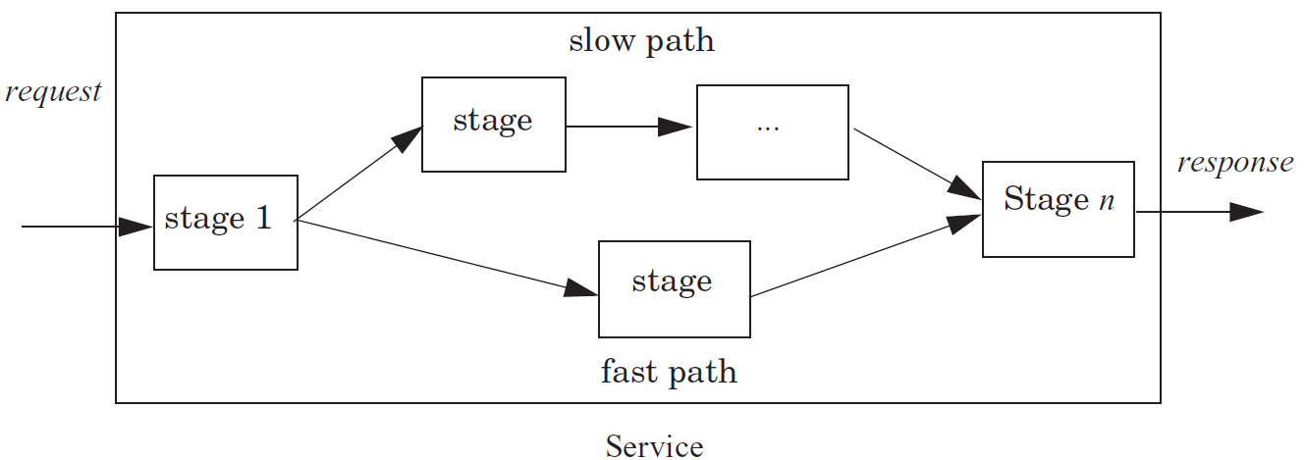
Fast Path for Latency Optimizations
Use knowledge of the workload to make frequent cases faster
    if (WorksOnFastPath(request))
    DoFastCase(request);
    else
    DoNormalCase(request);

Slide 25
Fast Path for Latency Optimizations
Example: Fast Path and Slow Path
  AverageLatency = Frequencyfast x Latencyfast + Frequencyslow x Latencyslow
  Worthwhile in fast path is frequent enough to lower average
  Need to factor in slow down to slow path of optimization

Slide 26
Caching – Classic Fast Path
Use knowledge of workload
  Works on memory abstractions
Keep common requests in a fast local memory
  Check the local memory every access
Example:
  CPU cache – Cache 1ns, Memory 100ns, .90 hit rate
  AverageLatency = .9 x 1ns + .1 x 100ns = 10.9 ns
    Order of magnitude improvement
Used everywhere there are memory abstractions
  Processors, file systems, TLBs, browsers, DNS, etc.

Slide 27
Another Fast Path Example
Consider a request stream of different types
  Some very simple and some very complex
Optimization:
  if (FastPath(request)) {
  Handle simple cases in highly optimized code
  } else {
  Handle request in full generality
  }

Slide 28

Using Concurrency to Reduce Latency
Consider a water pipe
In principle you can use n threads to get a speedup of n
  1 CPU
  2 CPU
  Hard to get the ideal speedup
Examples:
  Google search engine

Slide 29
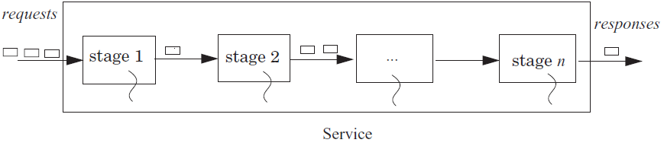
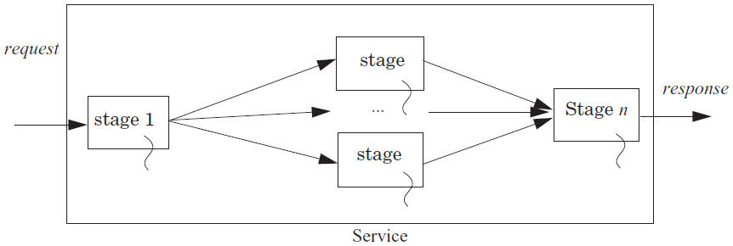
Using Concurrency to Reduce Latency

Slide 30
Hiding Latency
Hide latency by overlapping with other requests
  Improves throughput
Example:
  Fetch (5 units) and process (5 units) 2 blocks
    Fetch B1; Process B1; Fetch B2; Process B2; 20 time units
  Fetch 2 blocks asynchronously
    Send request for B1,B2; Receive B1; Process B1; Receive B2; Process B2 15 time units
Examples:
  Processors prefetching memory requests
  File systems preteching files
  Browser prefetching pages

Slide 31
Outline
Performance
  Fighting bottlenecks
  An example: the I/O bottleneck
Multilevel Memories
  Multilevel memory management mechanism
  Locality of reference and working sets
  Multilevel memory management policies
Scheduling
  Scheduling Metrics
  Scheduling Policies
Suggested reading
  6.1, 6.2， 6.3

Slide 32
Review
Reducing Latency
  by exploiting workload properties
  by concurrency (parallelizing)
Improving Throughput
  by concurrency (parallelizing & pipeline)
Challenges
  Queuing
Notes:
reducing latency by concurrent: google search engine: split web index

Slide 33
Queuing and Overload

Slide 34
Queuing and Overload
The offered load
  The requests
Overloaded
  load >= “#”
Avoid the overload
  matches
Notes:
The offered load
The rate of arrival of requests for service
Overloaded
Whenever the offered load is greater than the capacity of a service for some duration
Avoid the overload
The capacity just matches the offered load of requests

Slide 35
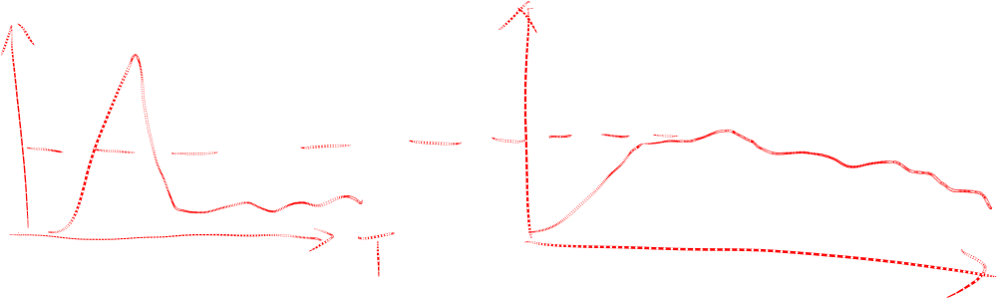
Queuing and Overload
If overload in short time
If overload persists over long periods of time
  Increase the capacity of the system
  Shed load
Notes:
If overload in short time
a queue handles short bursts of too much demand by time-averaging with adjacent periods when there is excess capacity

Slide 36
Queuing and Overload
Control offered load
  Bounded buffer
    self managing---(feedbackd)
    not to make the request at all
    holds on to the request and resubmits it later
    put a quota
  Reducing the offered load when a stage becomes overloaded
    e.g. swap out

Slide 37
Fighting Bottlenecks
Three different techs
  Batching
  Dallying
  Speculation

Slide 38
Batching
group requests == more efficiently
  Amortize overheads of processing
  Schedule requests for better performance
Examples:
  N messages vs 1 message with N requests Disks:
    Always transfer a bunch of bytes (sector or block)
    Schedule the disk motions

Slide 39
Dallying---（delay）
Procrastination sometimes helps
  Temp files – deleted before written to disk
Examples:
  Caches – Write back policy
    Write absorption
  Database transactions – group commit
    Might hold your ATM request until others arrive to do batching

Slide 40
Speculation
Guessing and performing ahead
Examples:
  Processors guess at branches, memory access
  File systems guess at next file block needed ----Called prefetching
  Easier if only 2 or 3 possibilities
    Branch prediction v.s. value prediction
Notes:
Guessing at a operation and performing it ahead a time

Slide 41
The I/O Bottleneck
The average seek latency
  The average time to move the head : 1/3 of the disk
  about 8 milliseconds.
The average rotational latency
  The disks spin at 7200 rotations/minute
  One rotation every 8.33 milliseconds
  On average, the disk has to wait a half --4.17 milliS
Notes:
the disk has to wait a half rotation for the desired block to be under the disk head -----4.17 milliseconds

Slide 42
The I/O Bottleneck
Bits read from a disk encounter two potential transfer rate limits
  The rate at which bits spin under the disk heads on their way to a buffer
  The rate at which the I/O channel or I/O bus can transfer the contents of the buffer to the computer

Slide 43

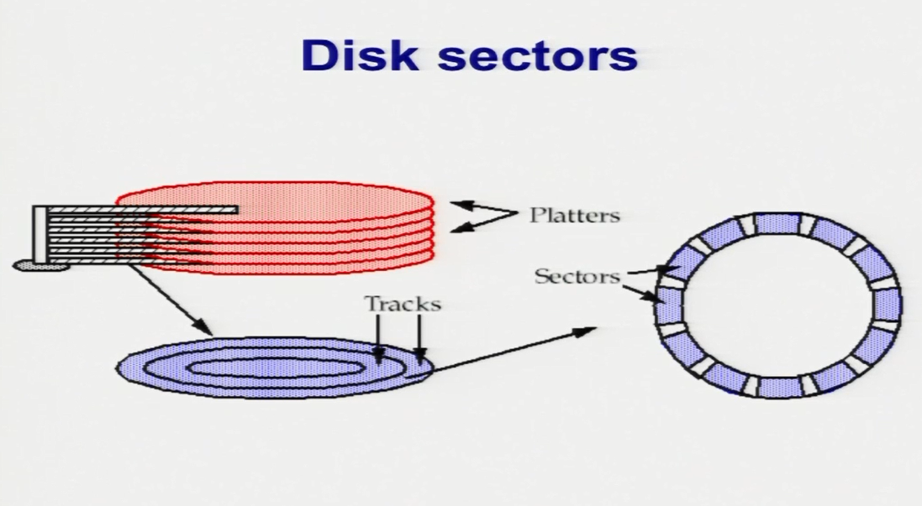

Slide 44
The I/O Bottleneck
A typical modern 400 gigabyte disk
  Has 16,383 cylinders, 24 megabytes per cylinder
  Would have 8 two-sided platters and thus 16 read/write heads
  Would be 24/16 = 1.5 megabytes /track
  rotating at 7200/minute = 120 R/sec
  The bits will go by a head at
  1.5M*120 = 180 megabytes/ second

Slide 45
The I/O Bottleneck
The Integrated Device Electronics (IDE) bus
  66 megabytes per second is a common number
The Serial ATA3 bus
  3 gigabytes per second
With the IDE bus
  The electronics would be the bottleneck at 66 megabytes/second
With a Serial ATA3 bus
  The mechanics would be the bottleneck at 180 megabytes/second

Slide 46
The I/O Bottleneck (read 4k )
Read a 4 kilobyte block chosen at random takes
  average seek time + average rotation latency + transmission of 4 kilobytes
  = 8 + 4.17 + (4 / (180 × 1024)) × 1000 milliseconds
  = 8 + 4.17 + 0.02 milliseconds
  = 12.19 milliseconds
The throughput for reading randomly-chosen blocks one by one is:
  = 4 kilobytes/12.19 miliS ×1000 per second
  = 328 kilobytes/second

Slide 47
The I/O Bottleneck (read and write 4k every time )
1 in ← OPEN (“in”, READ) // open “in” for reading
2 out ← OPEN (“out”, WRITE) // open “out” for reading
3
4 while not ENDOFFILE (in) do
5 block ← READ (in, 4096) // read 4 kilobyte block from in
6 block ← COMPUTE (block) // compute for 1 millisecond
7 WRITE (out, block, 4096) // write 4 kilobyte block to out
8 CLOSE (in)
9 CLOSE (out)
reading 4 kilobyte + 1 millisecond of computation + writing 4 kilobyte
= 12.19 + 1+ 12.19 milliseconds
= 25.38 milliseconds.

Slide 48
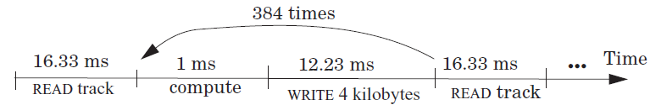
The I/O Bottleneck (read 1 track)
Modify the file system
  to layout the blocks of a file contiguously
  to prefetch an entire track of data on each read
  average seek time + 1 rotational delay
  = 8 + 8.33 milliseconds
  = 16.33 milliseconds

Slide 49
The I/O Bottleneck
The average time for 384 iterations is:
  = reading 1536 kilobyte + 384× (1 millisecond of computation + writing 4 kilobyte)
  = 16.33 + 384 × (1 + 12.19) millisecond
  = 16.33 + 5065 milliseconds
  = 5081 milliseconds.
Thus, the average time for a loop iteration is 5081/384 = 13.23 milliseconds, a substantial improvement over 25.38 milliseconds.

Slide 50
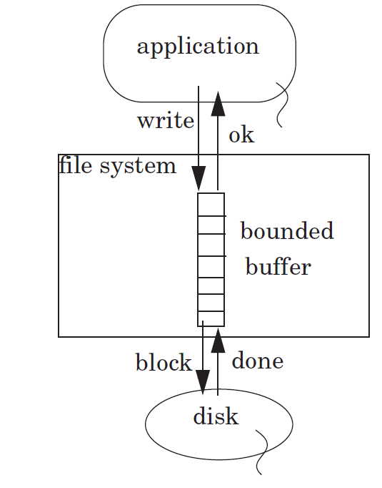

Slide 51
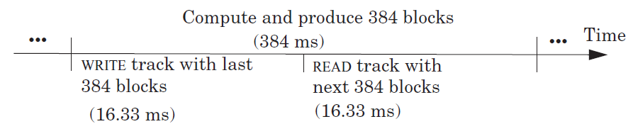
The I/O Bottleneck (with FS buffer)
  = (16.33 + 384 + 16.33)/384 milliseconds
  = 1.09 milliseconds

Slide 52
The I/O Bottleneck
A buffer without write-through
  performance improvements
  but can lose on reliability.
    If the computer system fails before flushing
The longer to delay writes
  the larger the opportunity for higher performance
  but the greater the probability that data will be lost
    if, for example, the power fails and the volatile RAM resets
Notes:
If the computer system fails before flushing to the file system has written out data to the disk, some data is lost

Slide 53
Memory Characterization
Memory Characterization

Slide 54
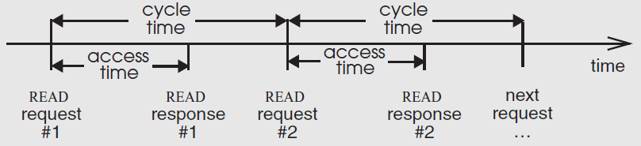
Memory Characterization
Capacity
Average random latency
  Has improved by only a factor of 2 in the last 20 yrs
Cost
Cell size
Throughput

Slide 55
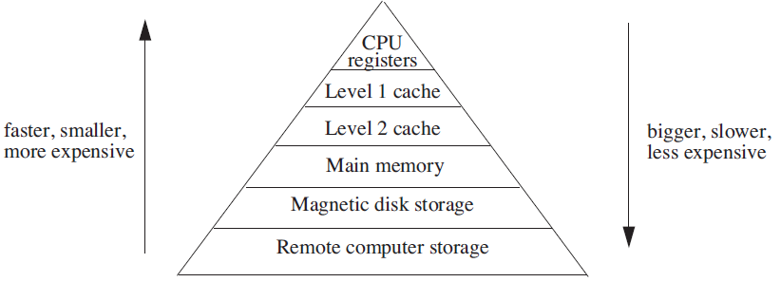
Multilevel Memory Pyramid

Slide 56
How to Manage a Multilevel Memory
User management
  Let programmer decides use :
    Scratchpad memory
    Registers
Automatic management
  A subsystem decides
    where to place the data items
    when to move them from one device to another
Notes:
Automatic management
A subsystem independent of applications

Slide 57
Why Automatic
Good performance on average
Relieve the programmer
  For user it is hard: place data in different layers, move data
Notes:
Relieve the programmer of the need to conform the program to specifics of the memory system

Slide 58
Two Memory Interfaces
READ/WRITE
  An interface to small-cell memory
  Higher levels usually have small-cell memory
GET/PUT
  An interface to large-cell memory
  Lower levels typically have large-cell memory

Slide 59
Virtualize READ/WRITE interface
Virtualize READ/WRITE interface
  It appears to apply to the entire memory system
  Combined with virtual memory manager
  decouple modules with indirection
Translate a virtual address to
  different physical memory addresses
  addresses in a different memory level
Rearrange the data among the memory levels
  without having to modify any application program

Slide 60
Virtualize READ/WRITE interface
By using an indirection exception
  The rearrangement can become automatic.
The indirection exception is page fault
  a memory reference exception that indicates that memory manager cannot translate a particular virtual address
The exception handler
  examines the virtual address
  may bind or rebind that value before resuming the interrupted thread

Slide 61
Virtualiz：easy to Add New Features
Memory-mapped files
  mapping files into an application’s address space
Copy-on-Write
  Mapping pages with only READ permission
On-demand zero-filled pages
  Mapping pages without READ and WRITE permissions
One zero-filled page
  Implementing on-demand zero-filled pages with copy-on-write
Virtual shared memory
  Several threads running on different computers can share a single address space

Slide 62
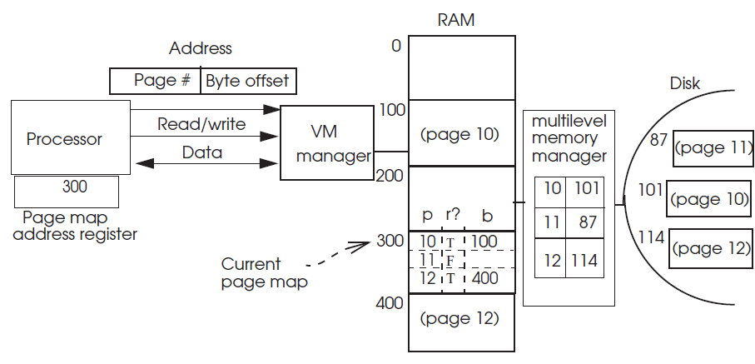
Adding Multilevel Memory Management to a Virtual Memory
Adding a bit to each entry of the page map
  Resident bit

Slide 63
Adding Multilevel Memory Management to a Virtual Memory
1 procedure TRANSLATE (integer virtual, perm_needed) returns physical
2 page ← virtual[0:41] // Extract page number (bits go left to right)
3 offset ← virtual[42:63] // Extract offset
4 page_table ← PMAR // Use the current page table
5 perm_page ← page_table[page].permissions // Lookup permissions for page
6 if PERMITTED (perm_needed, perm_page) then
7 block ← page_table[page].address // Index into page map
8 physical ← block + offset // Concatenate block and offset
9 return physical // return physical address
10 else return error

Slide 64
Adding Multilevel Memory Management to a Virtual Memory
7.1 if resident of page_table[page] = FALSE then // check if page is resident
7.2 signal MISSING_PAGE (page) // no, signal a missing-page exception
7.3 else
7.4 block ← page_table[page].address // Index into page map
8 physical ← block + offset // Concatenate block and offset
9 return physical // return physical address

